Slide 1
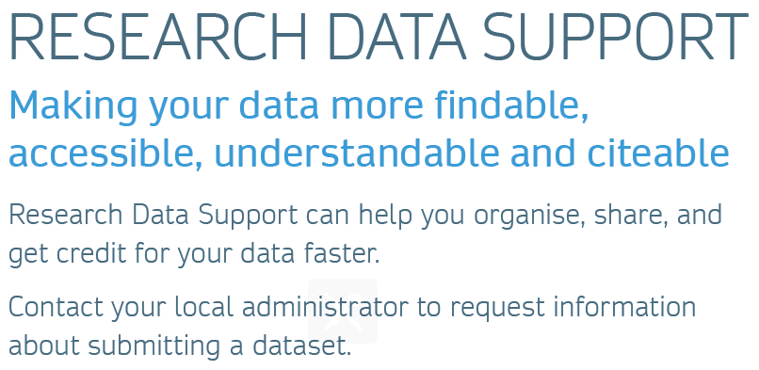
For more information about Research Data Support, visit: goo.gl/5KaXxh

